Slide 1
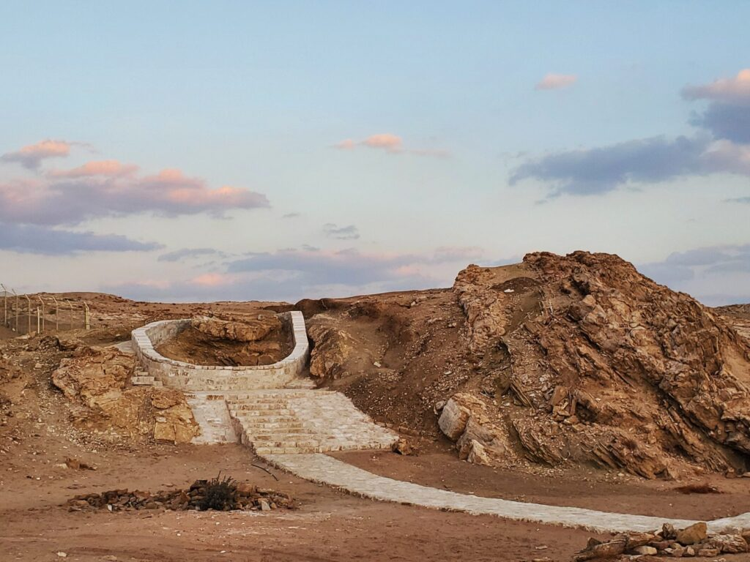
Exodus 2:16-22 出埃及記 二章16-22節
親子靈修 呂沈仁娣分享
08-08-2025
https://visitmountsinaiarabia.com/tour-places/well-of-moses-where-he-met-zippora/
Well of Moses: where he met Zippora
When Pharaoh heard of this, he tried to kill Moses, but Moses fled from Pharaoh and went to live in Midian, where he sat down by a well. Now a priest of Midian had seven daughters, and they came to draw water and fill the troughs to water their father’s flock (Exodus 2:15-16, NIV).

Slide 2
I、Bible Reading (NIV)-- Exodus 2:16-22
(Take turns reading either Chinese or English version)
https://www.biblegateway.com/passage/?search=Exodus%202%3A16-22&version=NIV
16 Now a priest of Midian had seven daughters, and they came to draw water and fill the troughs to water their father’s flock. 17 Some shepherds came along and drove them away, but Moses got up and came to their rescue and watered their flock.
18 When the girls returned to Reuel their father, he asked them, “Why have you returned so early today?”
19 They answered, “An Egyptian rescued us from the shepherds. He even drew water for us and watered the flock.”
20 “And where is he?” Reuel asked his daughters. “Why did you leave him? Invite him to have something to eat.”
21 Moses agreed to stay with the man, who gave his daughter Zipporah to Moses in marriage. 22 Zipporah gave birth to a son, and Moses named him Gershom,[a] saying, “I have become a foreigner in a foreign land.”

Slide 3
I-1. 讀經: 與兒女輪流讀(中或英)
經文選自：香港聖經公會
https://rcuv.hkbs.org.hk/RCUV2/EXO/2:16-22/
字義解説摘自：ttps://cmcbiblereading.com/2015/03/02/出埃及记第2章逐节注解、祷读/
出埃及記 2章16-22節-- | 字詞/文意解説
16米甸的祭司有七個女兒；她們來打水，打滿了槽，要給父親的羊群喝水。 | -- 米甸人也是亚伯拉罕的后代（创25:2）,「米甸的祭司」可能是事奉独一真神的(出18：11-12)。「槽」指井旁的水槽，人们从井中提水上来倒在槽中。 -- 这群坏牧羊人，等她们「打满了槽」(16节) 才赶她们走，坐享其成。 -- 「流珥」名字的意思是「神的朋友」，即「米甸祭司叶忒罗」(三1)。 -- 平日受坏牧羊人欺负，必须等他們的羊群喝足了，才轮到她们饮自己的羊群，所以很迟才回来。 「西坡拉」名字的意思是「鸟儿」。 「革舜」名字的意思是「异族人」。 --- 摩西替兒子取的名字，表明他已经接受自己是在地上「寄居的」，因此甘心做一个平凡无名的人，放下埃及所學的一切。
17有一些牧羊人來，把她們趕走，摩西卻起來幫助她們，取水給她們的羊群喝。
18她們回到父親流珥那裏；他說：「今日你們為何這麼快就回來了呢？」
19她們說：「有一個埃及人來救我們脫離牧羊人的手，他甚至打水給我們的羊群喝。」
20他對女兒們說：「那人在哪裏？你們為甚麼撇下他呢？去請他來吃飯吧！」
21摩西願意和那人同住， 那人就把女兒西坡拉給摩西為妻。
22西坡拉生了一個兒子，摩西給他起名叫革舜，因他說：「我在外地作了寄居者。」

Slide 4
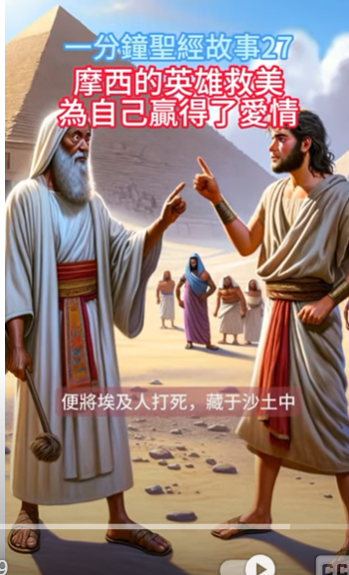
II. Film Watching Together–– The Story of Moses 親子同賞影帶-– 摩西的故事
Watch either one or both of the following film together
https://www.youtube.com/watch?v=SkjXBjUUnsE&t=5s
MOSES 3: Meet his wife Zipporah of Midian 💏 Animated Bible Stories | BIBTOONS GO
Apr 14, 2023
Moses kills an Egyptian soldier and flees from Egypt to the lands of Midian where he meets the daughters of the priest Reuel and helps them at the water well. Moses takes Zipporah as his wife and they have a son they named Gershom.
God had big plans for them.
This animation is based on the book of Exodus 2: 15 to 22.
https://www.youtube.com/watch?v=fk2uzrRdN-k
摩西英雄救美贏得愛情。摩西的仗義為他帶來了災禍，但他的英雄救美卻贏得了愛情
【一分鐘聖經故事 第027期】 #

Slide 5
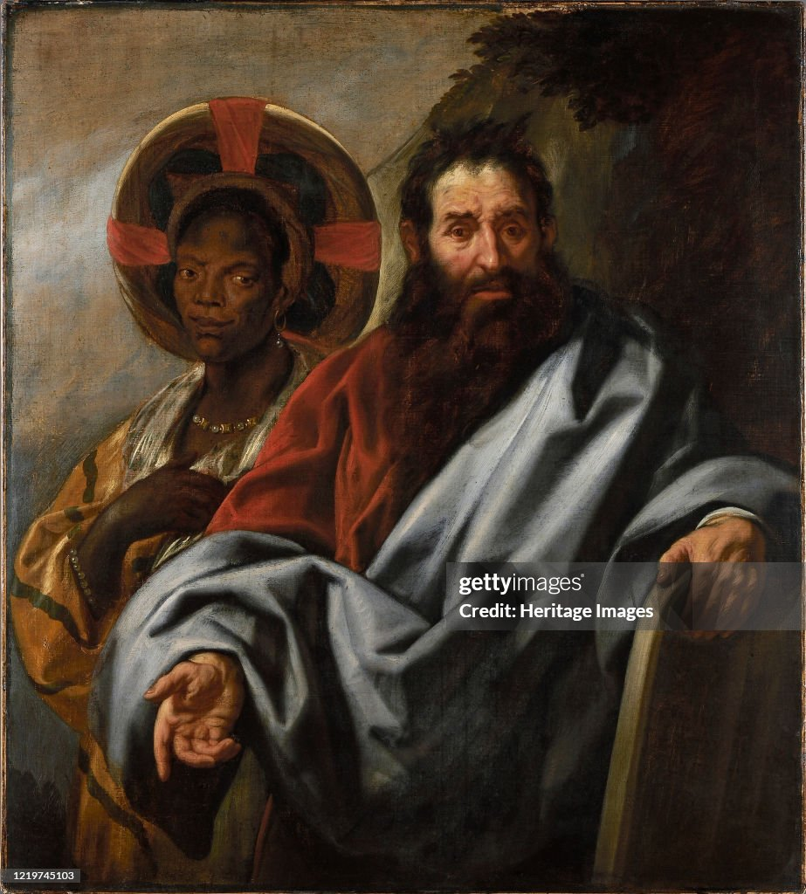
I-2. Guidelines For Brief Interaction (簡易互動原則）
Please do the following after read through the passage
(閲讀完經文后，請如此行)：
1. Briefly Clarify Unclear Points
簡單解釋不明字詞
2.Encourage Children Use Their Own Words To Tell The Story, the Scenario.
鼓勵兒女用自己的語言描述故事情境。
3. Or To Ask Whatever Questions Come To Their Mind.
或請兒女提出心中的疑問困擾;
4. Give a brief answer & follow up later.
簡要回答，隨後再跟進。
https://www.gettyimages.com/detail/news-photo/moses-and-his-ethiopian-wife-zipporah-between-1645-and-1649-news-photo/1219745103
Moses And His Ethiopian Wife Zipporah
Moses and his Ethiopian wife Zipporah, Between 1645 and 1649. Found in the Collection of Rubenshuis. Artist Jordaens, Jacob (1593-1678). (Photo by Fine Art Images/Heritage Images via Getty Images)
出 2：22 西坡拉生了一個兒子，摩西給他起名叫革舜，
因他說：「我在外地作了寄居者。」
†原文精要
革舜（םשֹׁגֵּרְ，gershom）有雙重意思：前兩個子音指「寄居」；前三個子音指「趕走」（二17，六1）。根據摩西對這名字的解釋，主要意思是「寄居」。
寄居者（גֵּר，ger）是放在這句話的開首─「寄居者，我是在異地」，有強調的作用。
（《出於神》謝挺 著；環球聖經公會 The Worldwide Bible Society； 2018年1月20日）
·

Slide 6
今
日
亮
1. 摩西看到七位女士受人欺壓，就起來鼎力相助！！而他的伸手幫助，為自己的一生帶來了翻轉與祝福，不僅有安身之処，還取了妻，建立家世，生養兒女，走出新路！！！
2. 當摩西给儿子起名叫革舜時，表明了他已接受自己是在地上「寄居的」(22節)，就像以色列人在埃及是寄居的身分。神也讓摩西體會寄居的滋味，好叫他能與以色列人認同。
反思： 請問您是個樂於隨時伸手助人的人嗎？而且，您確知自己是“寄居者”嗎？神為甚麼讓您有這樣的經歷？祂期望您與誰認同，好叫您能服事、祝福他們呢？（參：謝挺 著，《出於神》）
點

Slide 7

IV. Reflections–Parenting 教養反思 -- for young kids
教 养
您的小可愛是個以自我為中心的孩子，還是個樂於與人分享、幫助他人快樂孩童呢？
您有何妙方可不時地激動、鼓勵、肯定、贊美您的寶貝對身邊朋友的需要，常有正向回應呢？
https://img.tukuppt.com/photo-big/09/32/86/3464e30470d467b3181.jpg
智
慧

Slide 8

IV. Reflections–Parenting 教養反思--for older kids
智
教 养
慧
（1）聽聽您的愛子分享，一、二個實例，他/她曾如何具體而實際地去幫助他/她的朋友或兄弟姐妹？幫完后的感受如何？（聼完後，別忘帶著他/她一起禱告感謝神哦！！
（2）請您的寶貝孩子，想想上帝期望他/他/她能感受、體會那位朋友或家人、或堂兄弟姐妹所經歷的難處和不悅嗎？他/她曾如何聆聽、安慰或幫助對方呢？
（同心為他/她所提到的朋友、親人代禱！！）
https://img.lovepik.com/photo/50772/0271.jpg_wh860.jpg

Slide 9
IV. Reflections–Personal 個人反思
請思想：
1）在您生命中，神曾預備什麽人成爲您患難時幫助、傷痛時的安慰嗎？為他們感謝神！！
2）在您身邊有什麽人，神期待您能設身處地的瞭解、體諒、或説同理他/她的困境、局限、或軟弱嗎？您可以如何靠主的大愛、能力與智慧來接納、認同、服事與祝福他/她或他們嗎？
个 人 反 思

Slide 10
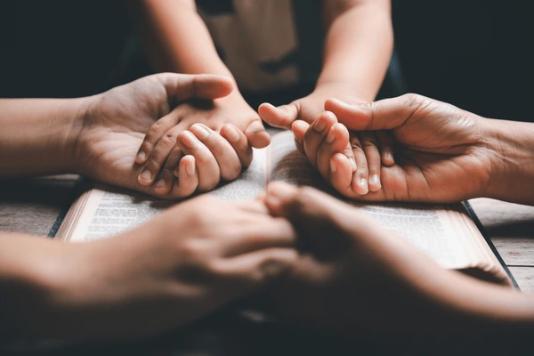
V-1. Closing Prayer 結束禱告
https://www.shutterstock.com/image-photo/christian-family-praying-together-concept-600nw-2291128441.jpg
Dear Lord, we are all sojourners! Not only are our days on earth limited, but our achievements are even more limited. Please teach me to cherish the grace and blessings you bestow upon me, transforming each of them into immediate encouragement and long-term blessings for those around me.
親愛的主啊, 我們都是寄居者！我們不僅在世的年日有限、成就更是有限。求主教導我珍惜您所賞賜的各樣恩典與祝福，把它們點點滴滴都轉化成身邊同行者當下的激勵與長遠的祝福！

Slide 11
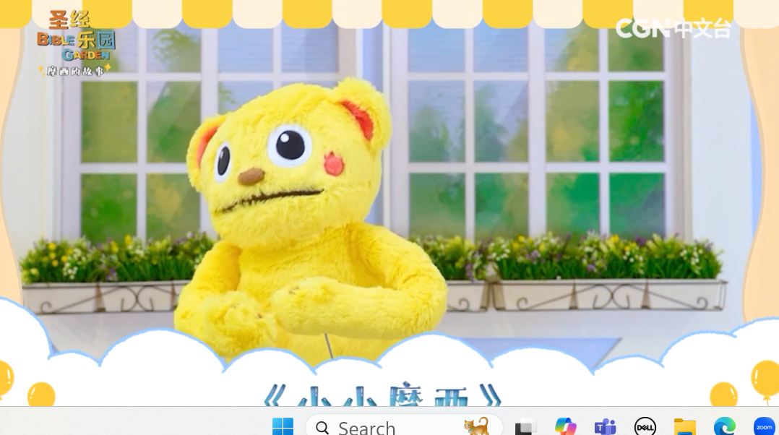

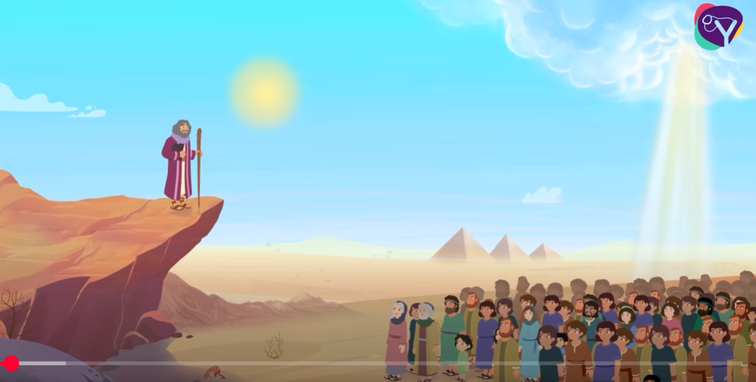
V-2. Closing Song 結束詩歌
https://www.youtube.com/watch?v=Xlbl_ya_6cM
【圣经乐园BIBLE GARDEN】
（简）诗歌敬拜EP12_《小小摩西》
CGN Chinese/ Time 1:40
https://www.youtube.com/watch?v=AJXUtFfDXHs
Little Mo' (The Story of Moses) - Animated, with Lyrics / Time 3: 39
DG Bible Songs
-- God has a plan for your life!!!!

Slide 12
MORE。。。。。。

Slide 13
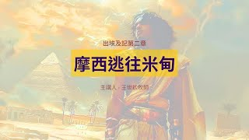
More。。。。 恩言慧語-- For parents
https://www.youtube.com/watch?v=hzHWO-DmzVE
摩西逃往米甸｜晨禱讀經 Ep.129｜出埃及記第二章15-25節｜
王世欽牧師｜ Apr 17, 2024
Time: 23:24
幸福城市教會HCC
《摩西逃往米甸》
在跟隨神的道路中，有時候我們會灰心喪志，放棄或是遺忘神所給我們的命定；但是神卻不會忘記祂的應許，也不停止祂的計劃。祂甚至能夠趁著我們身處曠野的時候在我們生命中動工，使我們可以承接祂給我們的使命。

Slide 14

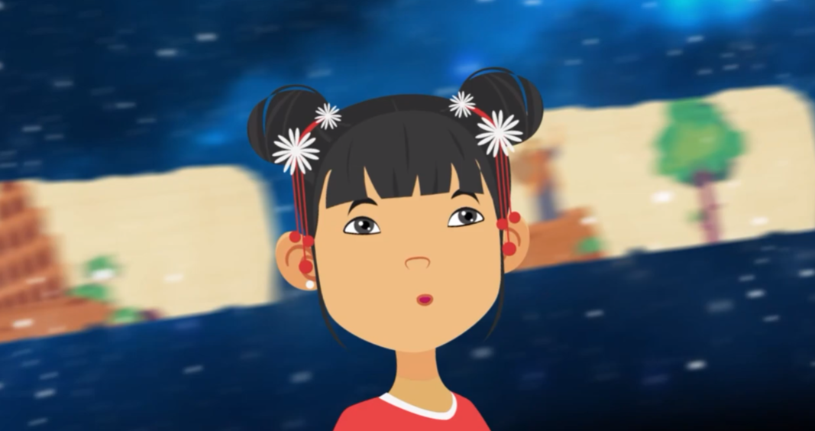
MORE。。。。。。
Film Watching – The Story of Moses（Kids alone or With Parents)
獎勵影帶 – 摩西的故事 （兒女單獨看或父母同觀賞）
More ... for children & Parents
1. 幸福兒童樂園【20200828】出埃及記2:11~22／兒童教育 泰山幸福教會 -- 中英文讀聖經&教學 Time：10:46 https://www.youtube.com/watch?v=rHVSdFXLY5o | https://www.youtube.com/watch?v=xSW7zWldxRY Moses Flees Egypt | Exodus 2 | Animated Bible Story for Kids Jun 30, 2025 Teach kids the Bible story of Moses fleeing Egypt. Kids will learn how to face their faults and troubles. You can read all about this Bible story in Exodus 2.

